Slide 1
Informed Search
Chapter 3.5 – 3.6, 4.1

Slide 2
function Uniform-Cost-Search (problem)
loop do
if Empty?(frontier) then return failure
node = Pop(frontier)
if Goal?(node) then return Solution(node)
Insert node in explored
foreach child of node do
if child not in frontier or explored then
Insert child in frontier
else if child in frontier with higher cost then
Remove that old node from frontier
Insert child in frontier
This is the algorithm in Figure 3.14 in the textbook; note that if child is not in frontier but is in explored, this algorithm will throw away child
Notes:
If child in frontier with lower cost then throw away child
If child in explored with lower cost then throw away child
Child in explored with higher cost is not possible because UCS expands nodes with increasing cost

Slide 3
Informed Search
Informed searches use domain knowledge to guide selection of the best path to continue searching
Heuristics are used, which are informed guesses
Heuristic means "serving to aid discovery"
Notes:
CLICK EACH

Slide 4
Informed Search
Define a heuristic function, h(n)
uses domain-specific information in some way
is (easily) computable from the current state description
estimates
the "goodness" of node n
how close node n is to a goal
the cost of minimal cost path from node n to a goal state
Notes:
CLICK EACH SUB

Slide 5
Informed Search
h(n) ≥ 0 for all nodes n
h(n) close to 0 means we think n is close to a goal state
h(n) very big means we think n is far from a goal state
All domain knowledge used in the search is encoded in the heuristic function, h
An example of a “weak method” for AI because of the limited way that domain-specific information is used to solve a problem (i.e., entirely contained in one function definition)
Notes:
CLICK EACH

Slide 6
Best-First Search
Sort nodes in the Frontier list by increasing values of an evaluation function, f(n), that incorporates domain-specific information
This is a generic way of referring to the class of informed search methods
Notes:
CLICK EACH

Slide 7
Greedy Best-First Search
Use as an evaluation function, f(n) = h(n), sorting nodes in the Frontier by increasing values of f
Selects the node to expand that is believed to be closest (i.e., smallest f value) to a goal node
Notes:
CLICK EACH

Slide 8
Greedy Best-First Search
f(n) = h(n)
S h=8
# of nodes tested: 0, expanded: 0
expnd. node | Frontier
 | {S:8}
1
5
8
A h=8
B h=4
C h=3
3
7
9
4
5
D h=∞
E h=∞
G h=0
Notes:
CLICK ANIM: 1. function, 2. graph, 3. table, 4. counts

Slide 9
Greedy Best-First Search
f(n) = h(n)
S h=8
# of nodes tested: 1, expanded: 1
expnd. node | Frontier
 | {S:8}
S not goal | {C:3,B:4,A:8}
1
5
8
A h=8
B h=4
C h=3
3
7
9
4
5
D h=∞
E h=∞
G h=0
Notes:
CLICK ONCE

Slide 10
Greedy Best-First Search
f(n) = h(n)
S h=8
# of nodes tested: 2, expanded: 2
expnd. node | Frontier
 | {S:8}
S | {C:3,B:4,A:8}
C not goal | {G:0,B:4,A:8}
1
5
8
A h=8
B h=4
C h=3
3
7
9
4
5
D h=∞
E h=∞
G h=0
Notes:
CLICK ONCE

Slide 11
Greedy Best-First Search
f(n) = h(n)
S h=8
# of nodes tested: 3, expanded: 2
expnd. node | Frontier
 | {S:8}
S | {C:3,B:4,A:8}
C | {G:0,B:4, A:8}
G goal | {B:4, A:8} not expanded
1
5
8
A h=8
B h=4
C h=3
3
7
9
4
5
D h=∞
E h=∞
G h=0
Notes:
CLICK ONCE

Slide 12
Greedy Best-First Search
f(n) = h(n)
S h=8
# of nodes tested: 3, expanded: 2
expnd. node | Frontier
 | {S:8}
S | {C:3,B:4,A:8}
C | {G:0,B:4, A:8}
G | {B:4, A:8}
1
5
8
A h=8
B h=4
C h=3
3
7
9
4
5
D h=∞
E h=∞
G h=0
Fast but not optimal
path: S,C,G cost: 13
Notes:
CLICK ANIM: 1. final graph, 2. path/cost, 3. fast…
show text example: traveling from Arad to Bucharest in Romania, h(n) is straight-line distance

Slide 13
Example: Find Path from Arad to Bucharest

Slide 14
Heuristic: Straight-Line Distance
380
234
374
226
253
176
366
199
193
329
244
100
151
80
241
161
242
160
77

Slide 15
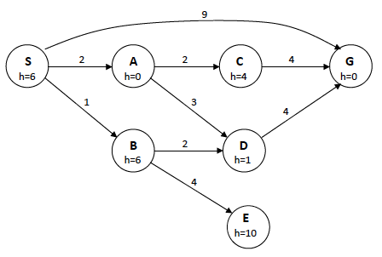
Example: Find Path from S to G in State-Space Graph

Slide 16
Greedy Best-First = ?
Notes:
Greedy Best-First: SAG. Solution path: SG

Slide 17
Greedy Best-First Search
S h=5
Not complete
Not optimal/admissible
2
2
A h=3
B h=4
Greedy search finds the left goal (solution cost of 7)
Optimal solution is the path to the right goal (solution cost of 5)
1
2
C h=3
D h=1
1
1
E h=2
G
goal
3
G
goal
Notes:
explain "greedy": choose the best that can be seen locally

Slide 18
Beam Search
Use an evaluation function f(n) = h(n) as in Greedy Best-First search, and restrict the maximum size of the Frontier to a constant, k
Only keep the k best nodes as candidates for expansion, and throw away the rest
More space efficient than Greedy Best-First Search, but may throw away a node on a solution path
Not complete
Not optimal/admissible
Notes:
CLICK EACH

Slide 19
Algorithm A Search
Use as an evaluation function f(n) = g(n) + h(n), where g(n) is minimum cost path from start to current node n (as defined in UCS)
The g term adds a “breadth-first component” to the evaluation function
Nodes in Frontier are ranked by the estimated cost of a solution, where g(n) is the cost from the start node to node n, and h(n) is the estimated cost from node n to a goal
Notes:
CLICK EACH

Slide 20
Is Algorithm A Optimal?
h=6
A
1
3
S
G
5
h=7
h=0
Notes:
No. Finds path SG because f(G) = 5+0 = 5 and S(A) = 1+6 = 7 but the optimal path is SAG

Slide 21
Algorithm A Search
S h=5
Not complete
2
1
A h=3
B h=1
Not optimal/admissible
Algorithm A never expands E because f(E) is bigger than all nodes below F
1
1
C h=3
D h=1
1
1
E h=∞
F
h=1
99
…
G
h=0
Notes:
CLICK ANIM: 1. not complete, 2. graph, 3. expands…, 4. not optimal

Slide 22
Algorithm A* Search
Use the same evaluation function used by Algorithm A, except add the constraint that for all nodes n in the search space, h(n) ≤ h*(n), where h*(n) is the actual cost of the minimum-cost path from n to a goal
The cost to the nearest goal is never over-estimated
When h(n) ≤ h*(n) holds true for all n, h is called an admissible heuristic function
An admissible heuristic guarantees that a node on the optimal path cannot look so bad that it is never considered
Notes:
CLICK EACH
Admissibility: Optimistic heuristic function desired, since these can be corrected later as g(n) increases, where as pessimistic heuristic functions rarely get the opportunity to decrease, since other more promising looking nodes are expanded first.
"The Price is Right" game show pits four contestants against each other: objective is to be the closest to the price a product "without going over"
The contestants' bids do not count if they bid more than the cost of the product. This is the same constraint for heuristic functions that we call admissibility, that is, the heuristic can guess as high as it wants for the cost to the goal without going over.

Slide 23


Admissible Heuristics are Good for Playing The Price is Right

Slide 24
Algorithm A* Search
Complete
Optimal / Admissible
Notes:
CLICK EACH

Slide 25
Example
n | g(n) | h(n) | f(n) | h*(n)
S
A
B
C
D
E
G
S h=8
n | g(n) | h(n) | f(n) | h*(n)
S
A
B
C
D
E
G
1
5
8
A h=8
B h=4
C h=3
3
7
9
4
5
D h=∞
E h=∞
G h=0
g(n) = actual cost to get to node n from start
Notes:
CLICK ANIM: 1. graph, 2. table, 3. highlight of g(n), 4. defn of g(n)

Slide 26
Example
n | g(n) | h(n) | f(n) | h*(n)
S | 0
A
B
C
D
E
G
S h=8
1
5
8
A h=8
B h=4
C h=3
3
7
9
4
5
D h=∞
E h=∞
G h=0
g(n) = actual cost to get to node n from start
Notes:
CLICK ONCE

Slide 27
Example
n | g(n) | h(n) | f(n) | h*(n)
S | 0
A | 1
B
C
D
E
G
S h=8
1
5
8
A h=8
B h=4
C h=3
3
7
9
4
5
D h=∞
E h=∞
G h=0
g(n) = actual cost to get to node n from start
Notes:
CLICK ONCE

Slide 28
Example
n | g(n) | h(n) | f(n) | h*(n)
S | 0
A | 1
B | 5
C | 8
D
E
G
S h=8
1
5
8
A h=8
B h=4
C h=3
3
7
9
4
5
D h=∞
E h=∞
G h=0
g(n) = actual cost to get to node n from start
Notes:
CLICK ONCE

Slide 29
Example
n | g(n) | h(n) | f(n) | h*(n)
S | 0
A | 1
B | 5
C | 8
D | 1+3 = 4
E
G
S h=8
1
5
8
A h=8
B h=4
C h=3
3
7
9
4
5
D h=∞
E h=∞
G h=0
g(n) = actual cost to get to node n from start
Notes:
CLICK ONCE

Slide 30
Example
n | g(n) | h(n) | f(n) | h*(n)
S | 0
A | 1
B | 5
C | 8
D | 4
E | 1+7 = 8
G
S h=8
1
5
8
A h=8
B h=4
C h=3
3
7
9
4
5
D h=∞
E h=∞
G h=0
g(n) = actual cost to get to node n from start
Notes:
CLICK ONCE

Slide 31
Example
n | g(n) | h(n) | f(n) | h*(n)
S | 0
A | 1
B | 5
C | 8
D | 4
E | 8
G | 10/9/13
S h=8
1
5
8
A h=8
B h=4
C h=3
3
7
9
4
5
D h=∞
E h=∞
G h=0
g(n) = actual cost to get to node n from start
Notes:
CLICK ONCE

Slide 32
Example
n | g(n) | h(n) | f(n) | h*(n)
S | 0
A | 1
B | 5
C | 8
D | 4
E | 8
G | 10/9/13
S h=8
1
5
8
A h=8
B h=4
C h=3
3
7
9
4
5
D h=∞
E h=∞
G h=0
h(n) = estimated cost to get to a goal from node n
Notes:
CLICK ANIM: 1. highlight of h(n), 2. defn of h(n)

Slide 33
Example
n | g(n) | h(n) | f(n) | h*(n)
S | 0 | 8
A | 1
B | 5
C | 8
D | 4
E | 8
G | 10/9/13
S h=8
n | g(n) | h(n) | f(n) | h*(n)
S | 0 | 8
A | 1 | 8
B | 5 | 4
C | 8 | 3
D | 4 | ∞
E | 8 | ∞
G | 10/9/13 | 0
1
5
8
A h=8
B h=4
C h=3
3
7
9
4
5
D h=∞
E h=∞
G h=0
h(n) = estimated cost to get to a goal from node n
Notes:
CLICK ANIM: 1. 8, 2. others values

Slide 34
Example
n | g(n) | h(n) | f(n) | h*(n)
S | 0 | 8
A | 1 | 8
B | 5 | 4
C | 8 | 3
D | 4 | ∞
E | 8 | ∞
G | 10/9/13 | 0
S h=8
n | g(n) | h(n) | f(n) | h*(n)
S | 0 | 8 | 8
A | 1 | 8 | 9
B | 5 | 4 | 9
C | 8 | 3 | 11
D | 4 | ∞ | ∞
E | 8 | ∞ | ∞
G | 10/9/13 | 0 | 10/9/13
1
5
8
A h=8
B h=4
C h=3
3
7
9
4
5
D h=∞
E h=∞
G h=0
f(n) = g(n) + h(n) actual cost to get from start to n plus estimated cost from n to goal
Notes:
CLICK ANIM: 1. highlight of f(n), 2. defn of f(n), 3. values

Slide 35
Example
n | g(n) | h(n) | f(n) | h*(n)
S | 0 | 8 | 8
A | 1 | 8 | 9
B | 5 | 4 | 9
C | 8 | 3 | 11
D | 4 | ∞ | ∞
E | 8 | ∞ | ∞
G | 10/9/13 | 0 | 10/9/13
S h=8
1
5
8
A h=8
B h=4
C h=3
3
7
9
4
5
D h=∞
E h=∞
G h=0
h*(n) = true cost of minimum-cost path from n to a goal
Notes:
CLICK ANIM: 1. highlight of h*(n), 2. defn of h*(n)

Slide 36
Example
n | g(n) | h(n) | f(n) | h*(n)
S | 0 | 8 | 8 | 9
A | 1 | 8 | 9
B | 5 | 4 | 9
C | 8 | 3 | 11
D | 4 | ∞ | ∞
E | 8 | ∞ | ∞
G | 10/9/13 | 0 | 10/9/13
S h=8
1
5
8
A h=8
B h=4
C h=3
3
7
9
4
5
D h=∞
E h=∞
G h=0
h*(n) = true cost of minimum-cost path from n to a goal
Notes:
CLICK ONCE

Slide 37
Example
n | g(n) | h(n) | f(n) | h*(n)
S | 0 | 8 | 8 | 9
A | 1 | 8 | 9 | 9
B | 5 | 4 | 9
C | 8 | 3 | 11
D | 4 | ∞ | ∞
E | 8 | ∞ | ∞
G | 10/9/13 | 0 | 10/9/13
S h=8
1
5
8
A h=8
B h=4
C h=3
3
7
9
4
5
D h=∞
E h=∞
G h=0
h*(n) = true cost of minimum-cost path from n to a goal
Notes:
CLICK ONCE

Slide 38
Example
n | g(n) | h(n) | f(n) | h*(n)
S | 0 | 8 | 8 | 9
A | 1 | 8 | 9 | 9
B | 5 | 4 | 9 | 4
C | 8 | 3 | 11
D | 4 | ∞ | ∞
E | 8 | ∞ | ∞
G | 10/9/13 | 0 | 10/9/13
S h=8
1
5
8
A h=8
B h=4
C h=3
3
7
9
4
5
D h=∞
E h=∞
G h=0
h*(n) = true cost of minimum-cost path from n to a goal
Notes:
CLICK ONCE

Slide 39
Example
n | g(n) | h(n) | f(n) | h*(n)
S | 0 | 8 | 8 | 9
A | 1 | 8 | 9 | 9
B | 5 | 4 | 9 | 4
C | 8 | 3 | 11 | 5
D | 4 | ∞ | ∞
E | 8 | ∞ | ∞
G | 10/9/13 | 0 | 10/9/13
S h=8
1
5
8
A h=8
B h=4
C h=3
3
7
9
4
5
D h=∞
E h=∞
G h=0
h*(n) = true cost of minimum-cost path from n to a goal
Notes:
CLICK ONCE

Slide 40
Example
n | g(n) | h(n) | f(n) | h*(n)
S | 0 | 8 | 8 | 9
A | 1 | 8 | 9 | 9
B | 5 | 4 | 9 | 4
C | 8 | 3 | 11 | 5
D | 4 | ∞ | ∞
E | 8 | ∞ | ∞
G | 10/9/13 | 0 | 10/9/13
S h=8
n | g(n) | h(n) | f(n) | h*(n)
S | 0 | 8 | 8 | 9
A | 1 | 8 | 9 | 9
B | 5 | 4 | 9 | 4
C | 8 | 3 | 11 | 5
D | 4 | ∞ | ∞ | ∞
E | 8 | ∞ | ∞ | ∞
G | 10/9/13 | 0 | 10/9/13 | 0
1
5
8
A h=8
B h=4
C h=3
3
7
9
4
5
D h=∞
E h=∞
G h=0
h*(n) = true cost of minimum-cost path from n to a goal
Notes:
CLICK ONCE

Slide 41
Example
n | g(n) | h(n) | f(n) | h*(n)
S | 0 | 8 | 8 | 9
A | 1 | 8 | 9 | 9
B | 5 | 4 | 9 | 4
C | 8 | 3 | 11 | 5
D | 4 | ∞ | ∞ | ∞
E | 8 | ∞ | ∞ | ∞
G | 10/9/13 | 0 | 10/9/13 | 0
S h=8
1
5
8
A h=8
B h=4
C h=3
3
7
9
4
5
D h=∞
E h=∞
G h=0
optimal path = S,B,G
cost = 9
Notes:
CLICK ANIM: 1. final graph, 2. path/cost

Slide 42
Example
n | g(n) | h(n) | f(n) | h*(n)
S | 0 | 8 | 8 | 9
A | 1 | 8 | 9 | 9
B | 5 | 4 | 9 | 4
C | 8 | 3 | 11 | 5
D | 4 | ∞ | ∞ | ∞
E | 8 | ∞ | ∞ | ∞
G | 10/9/13 | 0 | 10/9/13 | 0
S h=8
1
5
8
A h=8
B h=4
C h=3
3
7
9
4
5
D h=∞
E h=∞
G h=0
Since h(n) ≤ h*(n) for all n,
h is admissible
Notes:
CLICK ANIM: 1. highlights, 2. defn of admissibility

Slide 43
Example: Find Path from S to G

Slide 44
A* = ?
Notes:
A* = SADBDG. Solution path: SBDG

Slide 45
Algorithm A* Search
Use the same evaluation function used by Algorithm A, except add the constraint that for all nodes n in the search space, h(n) ≤ h*(n), where h*(n) is the actual cost of the minimum-cost path from n to a goal
The cost to the nearest goal is never over-estimated
When h(n) ≤ h*(n) holds true for all n, h is called an admissible heuristic function
An admissible heuristic guarantees that a node on the optimal path cannot look so bad so that it is never considered
Notes:
CLICK EACH
Admissibility: Optimistic heuristic function desired, since these can be corrected later as g(n) increases, where as pessimistic heuristic functions rarely get the opportunity to decrease, since other more promising looking nodes are expanded first.
"The Price is Right" game show pits four contestants against each other: objective is to be the closest to the price a product "without going over"
The contestants' bids do not count if they bid more than the cost of the product. This is the same constraint for heuristic functions that we call admissibility, that is, the heuristic can guess as high as it wants for the cost to the goal without going over.

Slide 46
Admissible Heuristic Functions, h
8-Puzzle example
Which of the following are admissible heuristics?
1
5
1
2
3
Example State
Goal State
2
6
3
4
5
6
7
4
8
7
8
h(n) = number of tiles in wrong position
h(n) = 0
h(n) = 1
h(n) = sum of “Manhattan distance” between each tile and its goal location
Note: Manhattan distance = L₁ norm

Slide 47
Admissible Heuristic Functions, h
8-Puzzle example
Which of the following are admissible heuristics?
1
5
1
2
3
Example State
Goal State
2
6
3
4
5
6
7
4
8
7
8
h(n) = number of tiles in wrong position YES
h(n) = 0 YES, uniform-cost search
h(n) = 1 NO, goal state
h(n) = sum of “Manhattan distance” between each tile and its goal location YES

Slide 48
Admissible Heuristic Functions, h
Which of the following are admissible heuristics?
h(n) = h*(n)
h(n) = max(2, h*(n))
h(n) = min(2, h*(n))
h(n) = h*(n) – 2

Slide 49
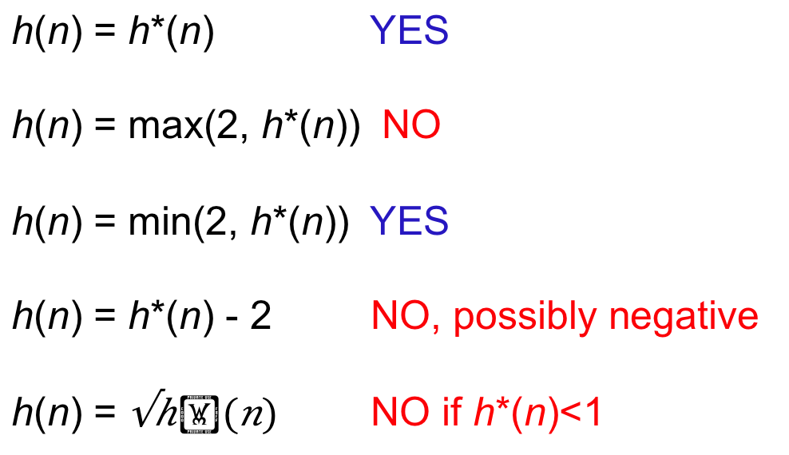
Admissible Heuristic Functions, h
Which of the following are admissible heuristics?
h(n) = h*(n) YES
h(n) = max(2, h*(n)) NO
h(n) = min(2, h*(n)) YES
h(n) = h*(n) - 2 NO, possibly negative
h(n) = $\sqrt{h∗(n)}$ NO if h*(n)<1

Slide 50
When should A* Stop?
A* should terminate only when a goal is removed from the priority queue
Same rule as for Uniform-Cost Search (UCS)
A* with h() = 0 is Uniform-Cost Search
B
1
999
h=1
S
G
h=2
h=0
1
C
1
h=2

Slide 51
A* Revisiting States
One more complication: A* might revisit a state (in Frontier or Explored), and discover a better path
Solution: Put D back in the priority queue, using the smaller g value (and path)
B
1
2
h=1
S
D
999
G
h=1
h=1
h=0
1
C
1
h=900
Notes:
Expand A, then B, then D, then C. Now we’ve found a cheaper path to D, so replace D (with parent B) in Frontier with new D (parent C)

Slide 52
Q2: A* Revisiting Expanded States
One more complication: A* might revisit a and discover a better path
Can you find the state in question?
B
1
2
h=1
S
D
999
G
h=1
h=1
h=0
1
C
1
h=900
Put D back into the priority queue, with the smaller g+h

Slide 53
A and A* Algorithm for General State-Space Graphs
Frontier = {S} where S is the start node
Explored ={}
Loop do
if Frontier is empty then return failure
pick node, n, with min f value from Frontier
if n is a goal node then return solution
foreach each child, n’, of n do
if n’ is not in Explored or Frontier
then add n’ to Frontier
else if g(n’) ≥ g(m) then throw n’ away
else add n’ to Frontier and remove m
Remove n from Frontier and add n to Explored
Variant of algorithm in Fig. 3.14
Note: m is the node in Frontier or Explored that is the same state as n’

Slide 54
A* Algorithm
Put the start node S in the Frontier list
If Frontier is empty, exit with failure
Remove from OPEN the node n for which f(n) is minimum and place it in CLOSED, the list of nodes that have been expanded
If n is a goal node, exit (for solution path trace back links from n to S)
Expand n, generating all its successors and store in them a link back to n.
For each successor n' of n
If n' is not already in either OPEN or CLOSED, calculate h(n'), g(n')=g(n)+ c(n,n'), f(n')=g(n')+h(n'), and place n' in OPEN
If n' is already in either OPEN or CLOSED, Check if g(n') is lower for the newly generated n'
If it is not lower, do nothing
If it is lower, replace existing n' with new g(n'), h(n'), link back to this n and, if in CLOSED, move node from CLOSED to OPEN
Goto 2
Notes:
CLICK EACH SUB
c(n,n') is the edge/arc cost from n to n'

Slide 55
Consistency
A heuristic, h, is called consistent (aka monotonic) if, for every node n and every successor n’ of n, the estimated cost of reaching the goal from n is no greater than the step cost of getting to n’ plus the estimated cost of reaching the goal from n’:
c(n, n’) ≥ h(n) − h(n’)
or, equivalently: h(n) ≤ c(n, n’) + h(n’)
Triangle inequality for heuristics
Implies values of f along any path are nondecreasing
When a node is expanded by A*, the optimal path to that node has been found
Consistency is a stronger condition than admissibility
Notes:
Every consistent heuristic must also be admissible.
Example on previous slide, h(C)=900, h(D)=1, c(C,D)=1 so 1 is NOT greater than or equal to 900 – 1 = 899. So this heuristic is NOT consistent.

Slide 56
Consistency
Is this h consistent?
h(C)=900, h(D)=1, c(C, D) = 1
but h(C) ≰ c(C,D) + h(D) since
900 ≰ 1 + 1, so h is NOT consistent (but h is admissible)
B
1
2
h=1
S
D
999
G
h=1
h=1
h=0
1
C
1
h=900
Notes:
To be consistent, h(C) <= c(n, n‘) + h(D), i.e., 900 <= 1 + 1, which is not true

Slide 57
A* Search
Is h is admissible and/or consistent?
f(n) = g(n) + h(n)
S h=8
# of nodes tested: 0, expanded: 0
expnd. node | Frontier
 | {S:0+8}
1
5
8
A h=8
B h=4
C h=3
3
7
9
4
5
D h=∞
E h=∞
G h=0
h is consistent since h(S) – h(A) = 8 – 8 ≤ 1, etc.
and therefore is also admissible
Notes:
This h is both admissible and consistent. For example, h(S) – h(B) = 8 – 4 = 4 <= 5, and h(S) – h(A) = 8 – 8 = 0 <= 1

Slide 58
A* Search
f(n) = g(n) + h(n)
S h=8
# of nodes tested: 1, expanded: 1
expnd. node | Frontier
 | {S:8}
S not goal | {A:1+8,B:5+4,C:8+3}
1
5
8
A h=8
B h=4
C h=3
3
7
9
4
5
D h=∞
E h=∞
G h=0
Notes:
CLICK ONCE

Slide 59
A* Search
f(n) = g(n) + h(n)
S h=8
# of nodes tested: 2, expanded: 2
expnd. node | Frontier
 | {S:8}
S | {A:9,B:9,C:11}
A not goal | {B:9,G:1+9+0,C:11, D:1+3+∞,E:1+7+∞}
1
5
8
A h=8
B h=4
C h=3
3
7
9
4
5
D h=∞
E h=∞
G h=0
Notes:
CLICK ONCE

Slide 60
A* Search
f(n) = g(n) + h(n)
S h=8
# of nodes tested: 3, expanded: 3
expnd. node | Frontier
 | {S:8}
S | {A:9,B:9,C:11}
A | {B:9,G:10,C:11,D:∞,E:∞}
B not goal | {G:5+4+0,G:10,C:11, D:∞,E:∞} replace
1
5
8
A h=8
B h=4
C h=3
3
7
9
4
5
D h=∞
E h=∞
G h=0
Notes:
CLICK ONCE

Slide 61
A* Search
f(n) = g(n) + h(n)
S h=8
# of nodes tested: 4, expanded: 3
expnd. node | Frontier
 | {S:8}
S | {A:9,B:9,C:11}
A | {B:9,G:10,C:11,D:∞,E:∞}
B | {G:9,C:11,D:∞,E:∞}
G goal | {C:11,D:∞,E:∞} not expanded
1
5
8
A h=8
B h=4
C h=3
3
7
9
4
5
D h=∞
E h=∞
G h=0
Notes:
CLICK ONCE

Slide 62
A* Search
f(n) = g(n) + h(n)
S h=8
# of nodes tested: 4, expanded: 3
expnd. node | Frontier
 | {S:8}
S | {A:9,B:9,C:11}
A | {B:9,G:10,C:11,D:∞,E:∞}
B | {G:9,C:11,D:∞,E:∞}
G | {C:11,D:∞,E:∞}
1
5
8
A h=8
B h=4
C h=3
3
7
9
4
5
D h=∞
E h=∞
G h=0
Pretty fast and optimal
path: S,B,G cost: 9
Notes:
show text example: traveling from Arad to Bucharest in Romania, g(n) actual road distance, h(n) is straight-line distance

Slide 63
Example: Find Shortest Route from Arad to Bucharest
Notes:
Cities in Romania

Slide 64
Heuristic: Straight-Line Distance to Bucharest
380
234
374
226
253
176
366
199
193
329
244
100
151
80
241
161
242
160
77

Slide 65
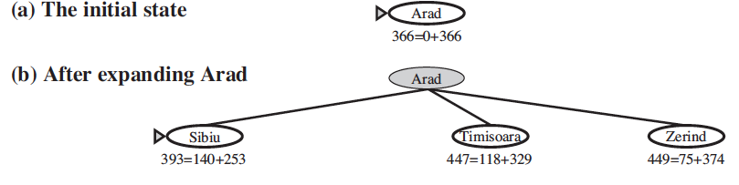
Notes:
Sibiu at front of Frontier so expand it next

Slide 66
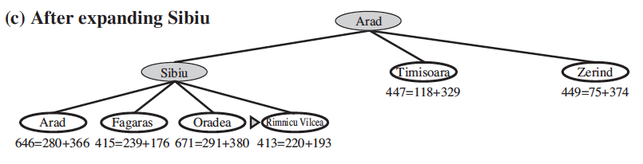
Notes:
Rimnicu Vilcea expanded next

Slide 67
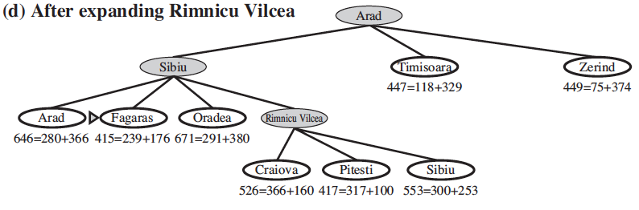

Slide 68
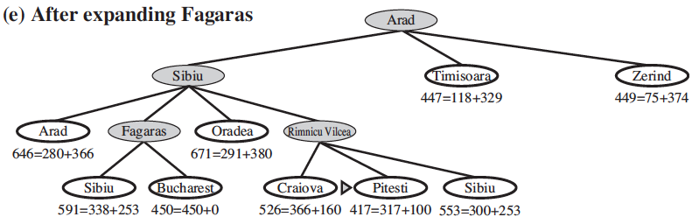

Slide 69
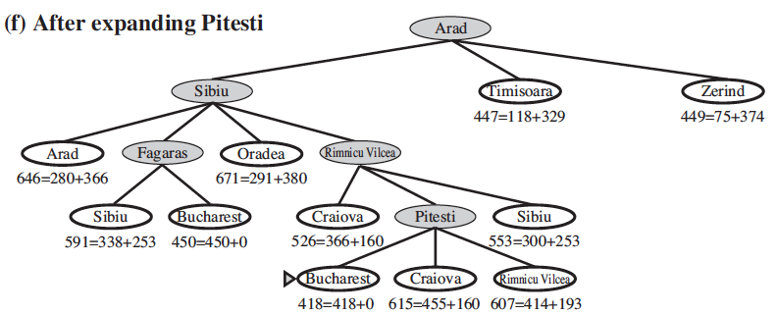

Slide 70
Visualizing Search Methods
http://qiao.github.io/PathFinding.js/visual/
BFS, UCS, Greedy Best-First, A*

Slide 71
QUIZ
What are Isaac Asimov’s “Three Laws of Robotics”?
A robot may not injure a human being or, through inaction, allow a human being to come to harm
A robot must obey the orders given it by human beings except where such orders would conflict with the First Law
A robot must protect its own existence as long as such protection does not conflict with the First or Second Laws

Slide 72
Where did these laws first appear?
In his short story Runaround (1942)
In his book I, Robot (1950)
What is the 0th Law?
0. A robot may not harm humanity, or, by inaction, allow humanity to come to harm
Notes:
The 0th law was added later by Asimov in his fiction when robots had taken responsibility for government of whole planets and human civilizations.

Slide 73
Proof of A* Optimality (by Contradiction)
Let
G be the goal in the optimal solution
G2 be a sub-optimal goal found using A* where f(n) = g(n) + h(n), and h(n) is admissible
f* be the cost of the optimal path from Start to G
Hence g(G2) > f*
That is, A* found a sub-optimal path (which it shouldn't)
Notes:
CLICK EACH SUB

Slide 74
Proof of A* Optimality (by Contradiction)
Let n be some node on the optimal path but not on the path to G2
f(n) ≤ f*
by admissibility, since f(n) never overestimates the cost to the goal, it must be ≤ the cost of the optimal path
f(G2) ≤ f(n)
since G2 was chosen from Frontier rather than n for the sub-optimal goal to be found
f(G2) ≤ f*
combining equations
Notes:
CLICK EACH

Slide 75
Proof of A* Optimality (by Contradiction)
f(G2) ≤ f*
g(G2) + h(G2) ≤ f*
by the definition of f
g(G2) ≤ f*
because h(G2) = 0 since G2 is a goal node
This contradicts the assumption that G2 was sub-optimal, g(G2) > f*
Therefore, A* is optimal with respect to path cost; A* search never finds a sub-optimal goal
Notes:
CLICK EACH

Slide 76

A* : The Dark Side
A* can use lots of memory:
O(number of states)
For really big search spaces, A* will run out of memory

Slide 77
IDA* : Memory-Bounded Search
Iterative-deepening A*
Cutoff based on f = g + h value rather than depth
At each iteration do loop-avoiding DFS, not expanding any node with an f-value that exceeds current threshold
At each iteration increase the f-value threshold by setting it to the smallest f-value of any node that exceeded the cutoff in the previous iteration
Complete
Optimal / Admissible
Linear space required
Notes:
Avoids the overhead of maintaining Frontier list

Slide 78
Devising Heuristics
Heuristics are often defined by relaxing the problem, i.e., computing the exact cost of a solution to a simplified version of the problem
remove constraints
8-puzzle: Each tile moves independently
simplify problem
8-puzzle: 1 move to get a tile from current position to goal position
8-puzzle: A tile can move to any adjacent position ➔ Number of moves to get a tile to its goal position = Manhattan distance (aka L₁ distance)
Notes:
CLICK EACH SUB
For example, in the 8-puzzle, if we relax the assumption about how a tile can be moved so that any tile can be moved in a single step from any position to any other position, then this means that a solution costs only the number of misplaced tiles since each misplaced tile can now be moved in one step to its goal position. This heuristic is admissible because at each move just one tile moves one position, so this is the minimum number of steps to get each of the misplaced tiles to their goal position.
Similarly, if we assume that tiles in the 8-puzzle are restricted to moving one square horizontally or vertically at a time, but we relax the assumption that only one tile can occur at a board position at a time, then each tile can be moved independently to its goal position, taking a number of steps equal to the Manhattan distance from its start position to its goal position. This leads to a heuristic which is the sum of the distances of the misplaced tiles to their goal positions. This heuristic is admissible.

Slide 79
Comparing Iterative Deepening with A*
[from Russell and Norvig, Fig 3.29]
 | For 8-puzzle, average number of states expanded over 100 randomly chosen problems in which optimal path is length …
 | … 4 steps | … 8 steps | … 12 steps
Depth-First Iterative Deepening (IDS) | 112 | 6,300 | 3.6 x 10⁶
A* search using “number of misplaced tiles” as the heuristic | 13 | 39 | 227
A* using “Sum of Manhattan distances” as the heuristic | 12 | 25 | 73

Slide 80
Devising Heuristics
Ideally, we want an admissible heuristic that is as close to the actual cost without going over
Also, it must be relatively fast to compute
Trade off: use more time to compute a complex heuristic versus use more time to expand more nodes with a simpler heuristic
Notes:
CLICK EACH

Slide 81
Better Heuristics
Linear Conflict heuristic for 8-puzzle:
If 2 tiles are both in the same goal row but reversed positions, additional vertical moves should be added to the Manhattan distance

Slide 82
Example: Linear Conflict
3
1
1
3
Manhattan distance is 2 + 2 = 4 moves

Slide 83
Example: Linear Conflict
3
1
1
3
Manhattan distance is 2 + 2 = 4 moves

Slide 84
Example: Linear Conflict
3
1
3
1
Manhattan distance is 2 + 2 = 4 moves

Slide 85
Example: Linear Conflict
3
1
3
1
Manhattan distance is 2 + 2 = 4 moves

Slide 86
Example: Linear Conflict
3
1
3
1
Manhattan distance is 2 + 2 = 4 moves

Slide 87
Example: Linear Conflict
1
3
1
3
Manhattan distance is 2 + 2 = 4 moves

Slide 88
Example: Linear Conflict
1
3
1
3
6 moves required whereas Manhattan distance is 2 + 2 = 4, so linear conflict heuristic adds 2 additional moves for this pattern

Slide 89
More Complex Tile Interactions
14
7
3
Manhattan distance is 19 moves, but 31 moves are needed.
3
7
15
12
11
11
13
12
13
14
15
7
13
3
Manhattan distance is 20 moves, but 28 moves are needed
12
7
15
3
11
11
14
12
13
14
15
12
11
3
Manhattan distance is 17 moves, but 27 moves are needed
7
14
7
13
3
11
15
12
13
14
15

Slide 90
Pattern Database Heuristics
A pattern database is a complete set of such positions, with associated number of moves
e.g. a 7-tile pattern database for the Fifteen Puzzle contains 519 million entries

Slide 91
Heuristics from Pattern Databases
5
10
14
7
1
2
3
8
3
6
1
4
5
6
7
15
12
9
8
9
10
11
2
11
4
13
12
13
14
15
31 moves is a lower bound on the total number of moves needed to solve this particular state

Slide 92
Devising Heuristics
If h(n) = h*(n) for all n,
only nodes on optimal solution path are expanded
no unnecessary work is performed
If h(n) = 0 for all n,
the heuristic is admissible
A* performs exactly as Uniform-Cost Search (UCS)
The closer h is to h*,
the fewer extra nodes that will be expanded
Notes:
CLICK EACH SUB

Slide 93
Devising Heuristics
If h1(n) ≤ h2(n) ≤ h*(n) for all n, then h2 dominates h1
h2 is a better heuristic than h1
A* using h1 (i.e., A1*) expands at least as many if not more nodes than using A* with h2 (i.e., A2*)
A2* is said to be better informed than A1*
Notes:
CLICK EACH SUB

Slide 94
Devising Heuristics
For an admissible heuristic
h is frequently very simple
therefore search resorts to (almost) UCS through parts of the search space
Notes:
CLICK EACH SUB

Slide 95
Devising Heuristics
If optimality is not required, i.e., a satisficing solution is okay,
Goal of the heuristic is then to get as close as possible, either under or over, to the actual cost
It results in many fewer nodes being expanded than using a poor, but provably admissible, heuristic
Notes:
CLICK EACH

Slide 96
Devising Heuristics
A* often suffers because it cannot venture down a single path unless it is almost continuously having success (i.e., h is decreasing); any failure to decrease h will almost immediately cause the search to switch to another path
Notes:
CLICK

Slide 97
Local Searching (Chapter 4.1)
Systematic (global) searching: Search for a path from start state to a goal state, then “execute” solution path’s sequence of operators
BFS, DFS, IDS, UCS, Greedy Best-First, A, A*, etc.
ok for small search spaces
not okay for NP-Hard problems requiring exponential time to find the (optimal) solution
Notes:
CLICK EACH SUB

Slide 98
Traveling Salesperson Problem (TSP)
A salesperson wants to visit a list of cities
stopping in each city only once
(usually also must return to the first city)
traveling the shortest distance
f = total distance traveled
Notes:
CLICK EACH SUB

Slide 99
Traveling Salesperson Problem (TSP)
Nodes are cities
Arcs are labeled with distances between cities
Adjacency matrix (notice the graph is fully connected):
5 City TSP (not to scale)
A
5
8
B
6
C
 | A | B | C | D | E
A | 0 | 5 | 8 | 9 | 7
B | 5 | 0 | 6 | 5 | 5
C | 8 | 6 | 0 | 2 | 3
D | 9 | 5 | 2 | 0 | 4
E | 7 | 5 | 3 | 4 | 0
9
7
5
2
5
3
D
E
4
Notes:
CLICK ANIM: 1. graph, 2. 5 City…, 3. CLICK EACH, 4. table

Slide 100
Traveling Salesperson Problem (TSP)
Nodes are cities
Arcs are labeled with distances between cities
Adjacency matrix (notice the graph is fully connected):
5 City TSP (not to scale)
A
5
8
B
6
C
 | A | B | C | D | E
A | 0 | 5 | 8 | 9 | 7
B | 5 | 0 | 6 | 5 | 5
C | 8 | 6 | 0 | 2 | 3
D | 9 | 5 | 2 | 0 | 4
E | 7 | 5 | 3 | 4 | 0
9
7
5
2
5
3
D
E
4
Notes:
CLICK ANIM: 1. graph, 2. 5 City…, 3. CLICK EACH, 4. table

Slide 101
Traveling Salesperson Problem (TSP)
a solution is a permutation of cities, called a tour
5 City TSP (not to scale)
A
5
8
B
6
C
 | A | B | C | D | E
A | 0 | 5 | 8 | 9 | 7
B | 5 | 0 | 6 | 5 | 5
C | 8 | 6 | 0 | 2 | 3
D | 9 | 5 | 2 | 0 | 4
E | 7 | 5 | 3 | 4 | 0
9
7
5
2
5
3
D
E
4
Notes:
CLICK ONCE

Slide 102
Traveling Salesperson Problem (TSP)
a solution is a permutation of cities, called a tour
e.g. A – B – C – D – E
5 City TSP (not to scale)
A
assume tours can start at any city and returns home at end
5
8
B
6
C
 | A | B | C | D | E
A | 0 | 5 | 8 | 9 | 7
B | 5 | 0 | 6 | 5 | 5
C | 8 | 6 | 0 | 2 | 3
D | 9 | 5 | 2 | 0 | 4
E | 7 | 5 | 3 | 4 | 0
9
7
5
2
5
3
D
E
4
Notes:
CLICK EACH (2)

Slide 103
How would you solve TSP using A or A* Algorithm?
How to represent a state?
Successor function?
Heuristics?

Slide 104
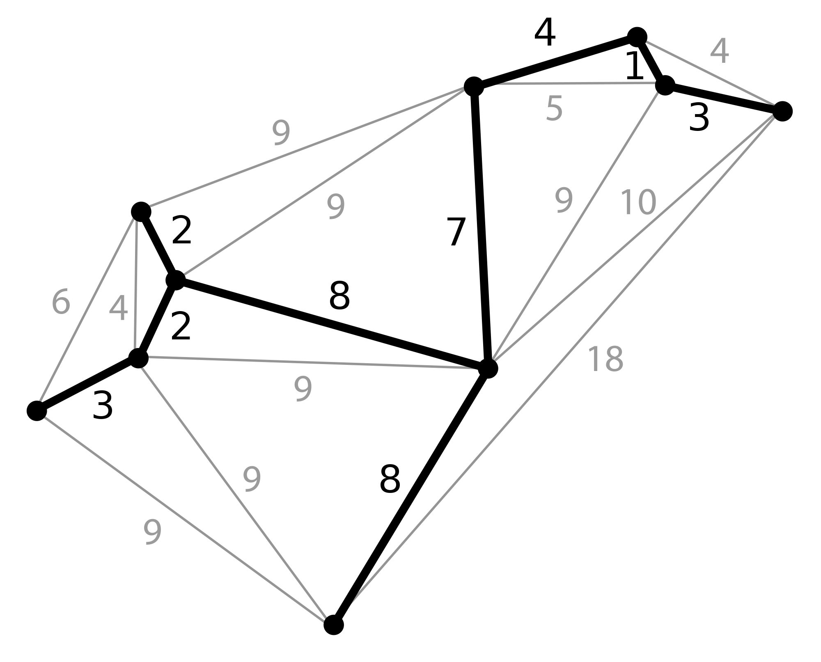
Heuristics
Is Straight-Line-Distance back to Start City admissible?
Is Minimum-Spanning-Tree length for all cities admissible?
Notes:
SLD is admissible because it just skips all remaining cities.
MST is admissible because it connects all cities but is based on a graph that is not necessarily a closed loop that visits each city exactly once.

Slide 105
Traveling Salesperson Problem (TSP)
Classic NP-Hard problem
How many solutions exist?
n! where n = # of cities
n = 5 results in 120 tours
n = 10 results in 3,628,800 tours
n = 20 results in ~2.4*10¹⁸ tours
5 City TSP (not to scale)
A
5
8
B
6
C
 | A | B | C | D | E
A | 0 | 5 | 8 | 9 | 7
B | 5 | 0 | 6 | 5 | 5
C | 8 | 6 | 0 | 2 | 3
D | 9 | 5 | 2 | 0 | 4
E | 7 | 5 | 3 | 4 | 0
9
7
5
2
5
3
D
E
4
Notes:
CLICK EACH

Slide 106
Solving Optimization Problems using Local Search Methods
Now a different setting:
Each state s has a score or cost, f(s), that we can compute
The goal is to find the state with the highest (or lowest) score, or a reasonably high (low) score
We do not care about the path
Use variable-based models
Solution is not a path but an assignment of values for a set of variables
Enumerating all the states is intractable
Previous search algorithms are too expensive

Slide 107
Traveling Salesperson Problem (TSP)
a solution is a permutation of cities, called a tour
e.g. A – B – C – D – E
5 City TSP (not to scale)
A
assume tours can start at any city and returns home at end
5
8
B
6
C
 | A | B | C | D | E
A | 0 | 5 | 8 | 9 | 7
B | 5 | 0 | 6 | 5 | 5
C | 8 | 6 | 0 | 2 | 3
D | 9 | 5 | 2 | 0 | 4
E | 7 | 5 | 3 | 4 | 0
9
7
5
2
5
3
D
E
4
Notes:
CLICK EACH (2)

Slide 108
Other Example Problems
N-Queens
Place n queens on n x n checkerboard so that no queen can “capture” another
f = number of conflicting queens
Boolean Satisfiability
Given a Boolean expression containing n Boolean variables, find an assignment of {T, F} to each variable so that the expression evaluates to True
(A ∨ ¬B ∨ C) ∧ (¬A ∨ C ∨ D)
f = number of satisfied clauses

Slide 109
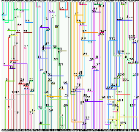
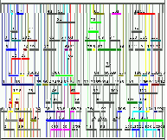
Example Problem: Chip Layout
Channel Routing
Lots of Chip Real Estate
Same connectivity, much less space

Slide 110
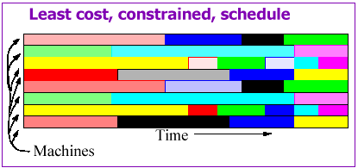
Example Problem: Scheduling
Also:
parking lot layout, product design, aero-dynamic design, “Million Queens” problem, radiotherapy treatment planning, …

Slide 111
Local Searching
Hard problems can be solved in polynomial time by using either an:
approximate model: find an exact solution to a simpler version of the problem
approximate solution: find a non-optimal solution to the original hard problem
We'll explore ways to search through a solution space by iteratively improving solutions until one is found that is optimal or near optimal
Notes:
CLICK EACH SUB

Slide 112
Local Searching
Local searching: every node is a solution
Operators/actions go from one solution to another
can stop at any time and have a valid solution
goal of search is to find a better/best solution
No longer searching a state space for a solution path and then executing the steps of the solution path
A* isn't a local search since it considers different partial solutions by looking at the estimated cost of a solution path
Notes:
CLICK EACH SUB

Slide 113
Informal Characterization
These are problems in which
There is some combinatorial structure being optimized
There is a cost function: Structure → Real number, to be optimized, or at least a reasonable solution is to be found
Searching all possible structures is intractable
There’s no known algorithm for finding the optimal solution efficiently
“Similar” solutions have similar costs

Slide 114
Local Searching
An operator/action is needed to transform one solution to another
TSP: 2-swap operator
take two cities and swap their positions in the tour
A-B-C-D-E with swap(A,D) yields D-B-C-A-E
possible since graph is fully connected
TSP: 2-interchange operator (aka 2-opt swap)
reverse the path between two cities
A-B-C-D-E with interchange(A,D) yields D-C-B-A-E
Notes:
CLICK EACH SUB

Slide 115
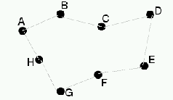
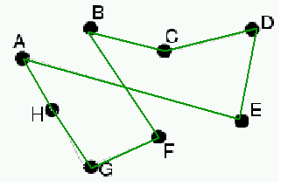
Neighbors: TSP
state: A-B-C-D-E-F-G-H-A
f = length of tour
2-interchange
A-B-C-D-E-F-G-H-A
flip
A-E-D-C-B-F-G-H-A

Slide 116
Local Searching
Those solutions that can be reached with one application of an operator are in the current solution's neighborhood (aka “move set”)
Local search considers next only those solutions in the neighborhood
The neighborhood should be much smaller than the size of the search space (otherwise the search degenerates)
Notes:
CLICK EACH

Slide 117
Examples of Neighborhoods
N-queens: Move queen in rightmost, most-conflicting column to a different position in that column
SAT: Flip the assignment of one Boolean variable

Slide 118
Neighbors: SAT
State: (A=T, B=F, C=T, D=T, E=T)
f = number of satisfied clauses
Neighbor: flip the assignment of one variable
(A=F, B=F, C=T, D=T, E=T)
(A=T, B=T, C=T, D=T, E=T)
(A=T, B=F, C=F, D=T, E=T)
(A=T, B=F, C=T, D=F, E=T)
(A=T, B=F, C=T, D=T, E=F)
A ∨ ¬B ∨ C
¬A ∨ C ∨ D
B ∨ D ∨ ¬E
¬C ∨ ¬D ∨ ¬E
¬A ∨ ¬C ∨ E

Slide 119
Local Searching
An evaluation function, f, is used to map each solution/state to a number corresponding to the quality/cost of that solution
TSP: Use the length of the tour; A better solution has a shorter tour length
Maximize f: called hill-climbing (gradient ascent if continuous)
Minimize f: called or valley-finding (gradient descent if continuous)
Can be used to maximize/minimize some cost
Notes:
CLICK EACH

Slide 120
Hill-Climbing (HC)
Question: What’s a neighbor?
Problem spaces tend to have structure. A small change produces a neighboring state
The size of the neighborhood must be small enough for efficiency
Designing the neighborhood is critical; This is the real ingenuity – not the decision to use hill-climbing
Question: Pick which neighbor?
The best one (greedy)
Question: What if no neighbor is better than the current state? Stop

Slide 121
Hill-Climbing Algorithm
Pick initial state s
Pick t in neighbors(s) with the largest f(t)
if f(t) ≤ f(s) then stop and return s
s = t. Goto Step 2.
Simple
Greedy
Stops at a local maximum

Slide 122
Hill-Climbing
Hill-climbing: Attempt to maximize f(X) by moving to the highest configuration in our moveset
Let X := initial state
Let E := f(X)
Let N = moveset_size(X)
For ( i = 0 ; i<N ; i := i+1) Let E_{i} := f(move(X,i))
If all E_{i}’s are ≤ E, terminate and return X
Else let i* = argmax_{i} E_{i}
X := move(X, i*)
E := E_{i*}
Goto 3

Slide 123
Hill-Climbing (HC)
HC exploits the neighborhood
like Greedy Best-First search, it chooses what looks best locally
but doesn't allow backtracking or jumping to an alternative path since there is no Frontier list
HC is very space efficient
Similar to Beam Search with a beam width of 1
HC is very fast and often effective in practice
Notes:
CLICK EACH SUB

Slide 124
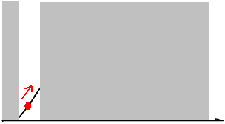
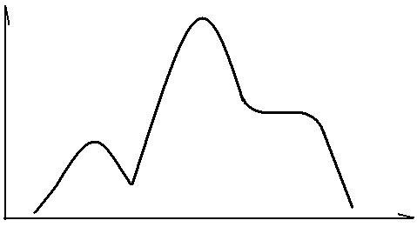
Local Optima in Hill-Climbing
Useful mental picture: f is a surface (‘hills’) in state space
But we can’t see the entire landscape all at once. Can only see a neighborhood; like climbing in fog
Global optimum, where we want to be
f
Current state
state
f
fog
state

Slide 125
Hill-Climbing
Visualized as a 2D surface
Height is quality/cost of solution f = f(x, y)
f(x, y)
Solution space is a 2D surface
Initial solution is a point
Goal is to find highest point on the surface of solution space
Hill-Climbing follows the direction of the steepest ascent, i.e., where f increases the most
x
y
Notes:
CLICK ANIM: 1. CLICK TWICE, 2. coordinates, 3. CLICK ONCE, 4. surface, 5. CLICK ONCE, 6. point, 7. CLICK TWICE, 8. arrow
show crumpled paper as solution surface and describe

Slide 126
Hill-Climbing (HC)
Solution found by HC is totally determined by the starting point; its fundamental weakness is getting stuck:
f(y)
At a local maximum
At plateaus and ridges
Global maximum may not be found
Trade off:
greedily exploiting locality as in HC
vs. exploring state space as in BFS
y
Notes:
CLICK ANIM: 1. solution text, 2. diagram, 3. local max text, 4. local max points, 5. plateau text, 6. plateau line,
7. global max text, 8. global max point, 9. trade off text
explain how start determines solution
HC starting is Madison would get stuck on Bascom hill

Slide 127
Difficulty in Searching for a Global Optimum (here shown as a Minimum)
barrier to local search
starting
point
descend
direction
local minimum
global minimum
Notes:
Local search techniques, such as steepest descend method, are very good in finding local optima. However, difficulties arise when the global optima is different from the local optima. Since all the immediate neighboring points around a local optima is worse than it in the performance value, local search can not proceed once trapped in a local optima point. We need some mechanism that can help us escape the trap of local optima. And the simulated annealing is one of such methods.

Slide 128
Hill-Climbing with Random Restarts
Very simple modification:
When stuck, pick a random new starting state and re-run hill-climbing from there
Repeat this k times
Return the best of the k local optima found
Can be very effective
Should be tried whenever hill-climbing is used
Fast, easy to implement; works well for many applications where the solution space surface is not too “bumpy” (i.e., not too many local maxima)

Slide 129
Hill-Climbing with Restarts
Run HC multiple times (independently) with randomly generated start solutions
Use best solution found
Fast, easy to implement, works well for many applications where the solution space surface is not too “bumpy” (i.e., not too many local maxima)

Slide 130
Escaping Local Maxima
HC gets stuck at a local maximum, limiting the quality of the solution found
Two ways to modify HC:
choice of neighborhood
criterion for deciding to move to neighbor
For example:
choose neighbor randomly
move to neighbor if it is better or, if it isn't, move with some probability, p
Notes:
CLICK EACH SUB

Slide 131
Variations on Hill-Climbing
Question: How do we make hill-climbing less greedy?
Stochastic Hill-Climbing
Randomly select among the neighbors
The better, the more likely
Question: What if the neighborhood is too large to easily compute? (e.g., N-queens and we need to pick both the column and the row within it)
First-choice hill-climbing
Randomly generate neighbors, one at a time
If neighbor is better, take the move

Slide 132
Life Lesson #237
Sometimes one needs to temporarily step backward in order to move forward
Lesson applied to iterative, local search:
Sometimes one needs to move to an inferior neighbor in order to escape a local optimum

Slide 133
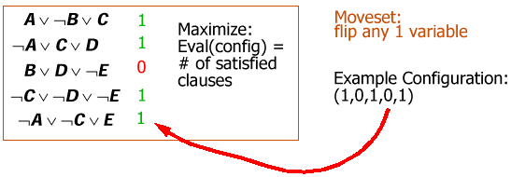
Hill-Climbing Example: SAT
i.e., A=true, B=false, etc.
5 Boolean variables: A, B, C, D and E
5 clauses

Slide 134
Variations on Hill-Climbing
WALKSAT [Selman, 1996]
Pick a random unsatisfied clause
Select and flip a variable from that clause:
With prob. p, pick a random variable
With prob. 1-p, pick variable that maximizes the number of satisfied clauses
Repeat until solution found or max number of flips attempted
A ∨ ¬B ∨ C
¬A ∨ C ∨ D
B ∨ D ∨ ¬E
¬C ∨ ¬D ∨ ¬E
¬A ∨ ¬C ∨ E
* This is the best known algorithm for satisfying Boolean formulas

Slide 135
Simulated Annealing (Stochastic Hill-Climbing)
Pick initial state, s
Randomly pick state t from neighbors of s
if f(t) better than f(s)
then s = t // t better than s so move there
else with small probability s = t
Goto Step 2 until some stopping criterion is met

Slide 136

Simulated Annealing
Origin:
The annealing process of heated solids –
Alloys manage to find a near global minimum energy state when heated and then slowly cooled
Intuition:
By allowing occasional ascent in the search process, we might be able to escape the traps of local minima
Introduced by Nicholas Metropolis in 1953
Notes:
The name of simulated annealing originates from the simulation of the annealing process of heated solids. “In condensed matter physics, annealing denotes a physical process in which a solid in a heat bath is heated up by increasing the temperature of the heat bath to a maximum value at which all particles of the solid randomly arrange themselves in the liquid phase, followed by cooling through slowly lowering the temperature of the heat bath. In this way, all particles arrange themselves in the low energy ground state of a corresponding lattice.” (quoted from Simulated Annealing: Theory and Applications)
In solving combinatorial optimization problems, we make an analogy to the aforementioned process. The basic idea is that by allowing the search process to proceed in an unfavorable direction occasionally, we might be able to escape the trap of local optima and reach the global optima.

Slide 137
Consequences of Occasional Bad Moves
Desired effect (when searching for a global minimum):
Advantage
Helps escape
local optima
Idea 1: Use a small, fixed probability threshold, say, p = 0.1
Disadvantage
But it might pass the global
optimum after reaching it
Notes:
However, like swords have two edges, there are two consequences of allowing occasional ascent steps. On one hand, it fulfills our desire to let the algorithm proceed beyond local optima. On the other hand, we might miss the global optimum by allowing the search process to pass through it. To maintain the desired effect and reduce the adverse effect, we need a sophisticated scheme to control the acceptance of occasional ascents, which is the heart of simulated annealing.

Slide 138
Escaping Local Optima
Modified HC can escape from a local optimum but
the chance of making a bad move is the same at the beginning of the search as at the end
the magnitude of improvement, or lack of, is ignored
Fix by replacing fixed probability, p, that a bad move is accepted, with a probability that decreases as the search proceeds
Now as the search progresses, the chance of taking a bad move goes down
Notes:
show crumpled paper as solution surface and seed as point on surface
describe how T is like shaking paper that lessens as search progresses

Slide 139
Control of Annealing Process
Acceptance criterion at each step (Metropolis Criterion) in Hill-Climbing:
Let the performance change be
ΔE = f(newNode) – f(currentNode)
Always accept an ascending step (i.e., better state)
Accept a descending step only if it passes a test based on two parameters, ΔE and T
Notes:
Suppose that a step in the search direction produce a difference of Δ in the performance value. The acceptance criterion, which is often referred to as Metropolis Criterion, is as follows:
If it is a favorable direction, say Δ ≤ 0, we always accept it. Otherwise, this step is accepted with a probability exp(-Δ/T), where T is a parameter.

Slide 140
Escaping Local Maxima
want to find the global maximum solution
search for a new node with a greater value of f
replace fixed threshold with a value, p, that decreases as the search proceeds (T is a “temperature” parameter that will change over time):
p = e (f(newNode) – f(currentNode) / T
Idea: p should decrease over time
Notes:
CLICK EACH SUB
show crumpled paper as solution surface and seed as point on surface
describe how T is like shaking paper that lessens as search progresses

Slide 141
Escaping Local Maxima
Let ΔE = f(newNode) – f(currentNode) < 0
p = e ^{ΔE / T} (Boltzman's equation*)
As ΔE → -∞, p → 0
i.e., as move gets worse, probability of taking it decreases exponentially
As T → 0, p → 0
i.e., as “temperature,” T, decreases probability of taking bad move decreases
Idea: p decreases as neighbor gets worse
* or Arrhenius's equation
Notes:
CLICK EACH SUB

Slide 142
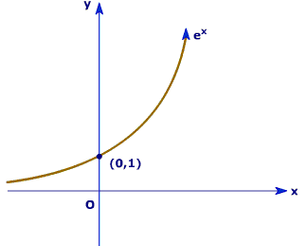
Probability of Moving to Worse State
x < 0 is region of interest

Slide 143
Escaping Local Maxima
Let ΔE = f(newNode) – f(currentNode)
p = e ^{ΔE / T}
ΔE << T
if badness of move is small compared to T, move is likely to be accepted
ΔE >> T
if badness of move is large compared to T,
move is unlikely to be accepted
Notes:
CLICK EACH SUB

Slide 144
Control of Annealing Process
Cooling Schedule:
T, the annealing “temperature,” is the parameter that control the probability of taking of bad steps
We gradually reduce the temperature, T(k)
At each temperature, the search is allowed to proceed for a certain number of steps, L(k)
The choice of parameters
is called the cooling schedule
Notes:
It is obvious that the parameter T plays a pivotal role in the acceptance criterion. The smaller the T is, the less likely an unfavorable step will be accepted. To obtain a desirable result, the parameter T will be gradually reduced as the algorithm proceeds. So at the beginning, T is large and thus the search can easily escape the trap of local optima. And later on, by reducing T, we allow the algorithm to converge. It is common practice that at each choice of T, we will allow the algorithm to proceed a certain steps, L(k). And the choice of the sequence of parameters {T(k), L(k)} is often called the cooling schedule.

Slide 145
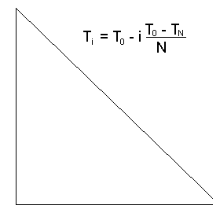
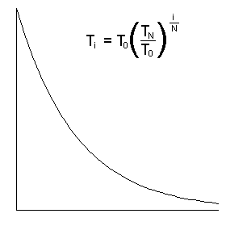
Simple Cooling Schedules
T
T
Iteration #
Iteration #

Slide 146
Simulated Annealing (Stochastic Hill-Climbing)
Pick initial state, s
k = 0
while k < kmax {
T = temperature(k)
Randomly pick state t from neighbors of s
if f(t) > f(s) then s = t
else if (e^{(f(t) – f(s))/ T} ) > random() then s = t
k = k +1
}
return s

Slide 147
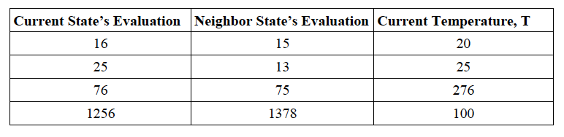
What is the probability of accepting each of the following moves assuming we are trying to maximize the evaluation function?
Notes:
f(current)=16, f(successor)=15, ΔE = -1, T=20, so p = 0.9512
f(current)=25, f(successor)=13, ΔE = -12, T=25, so p = 0.6188
f(current)=76, f(successor)=75, ΔE=-1, T=276, so p = 0.9964
f(current)=1256, f(successor)=1378, ΔE=122, T=100, so p = 1

Slide 148
p = e^{ΔE/T} where ΔE = f(successor) – f(current)
f(current)=16, f(successor)=15, ΔE = -1, T=20, so p = 0.9512
f(current)=25, f(successor)=13, ΔE = -12, T=25, so p = 0.6188
f(current)=76, f(successor)=75, ΔE=-1, T=276, so p = 0.9964
f(current)=1256, f(successor)=1378, ΔE=122, T=100, so p = 1

Slide 149
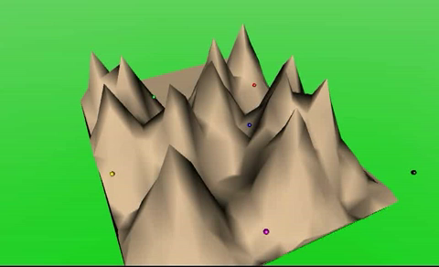
Simulated Annealing Demo
Searching for a global minimum

Slide 150
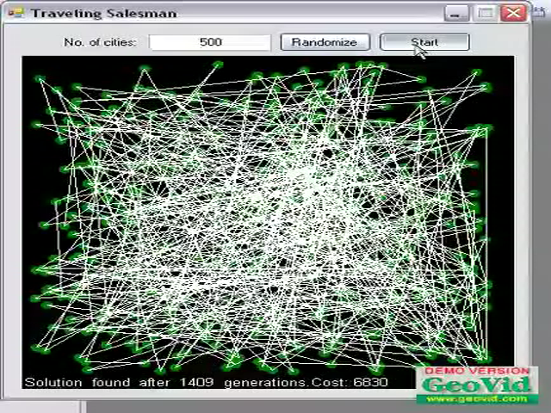
SA for Solving TSP

Slide 151
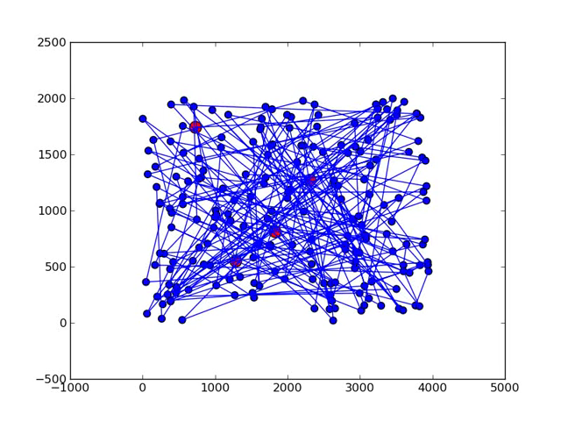
SA for Solving TSP

Slide 152
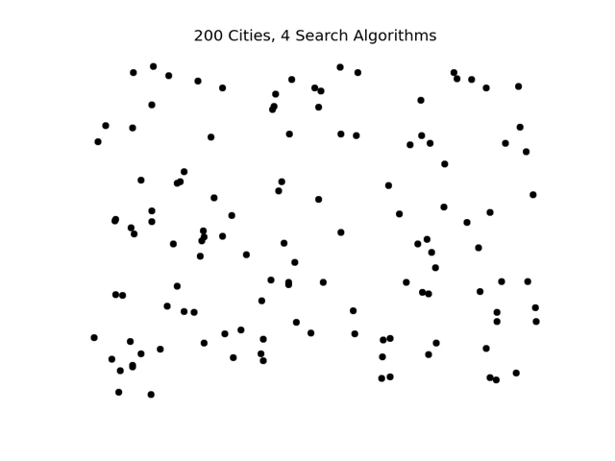
TSP – 4 Algorithms
Notes:
200 cities. Assumes roads between every pair of cities.
Random tour -- tour length = 327,452
Greedy Best-First using closest next city -- tour length = 36,226
Local Search using 2-interchange operator – tour length = 31,887
Simulated Annealing – tour length = 30,944

Slide 153
Tour Length Comparison
Random tour: 327,452
Greedy Best-First using closest next city: 36,226
Local search using 2-Interchange operator: 31,887
Simulated Annealing: 30,944

Slide 154
Simulated Annealing
//finds minima, VF valley finding
Node simulatedAnnealing (Problem problem) {
int temperature = problem.getIntialTemperature();
Node currentNode = new Node(problem.getStartPoint());
Node bestNode = currentNode;
while (temperature > problem.getStoppingTemperature()) {
Node newNode = random neighbor of currentNode;
check if newNode is accepted
check if newNode is better than bestNode
temperature = problem.schedule(temperature);
}
return bestNode;
}
Notes:
CLICK EACH SUB
The name for this approach comes from metallurgy and chemistry. The process of annealing is the gradual cooling of metals to increase their strength. Rapid cooling does not allow for the atoms to settle down into their lowest activation levels, causing brittleness. The slow reduction of temperature facilitates a stronger binding of the metal. We make the analogy to optimization by allowing our solution to wander randomly at first, then gradually decrease the chance of fluctuation to worse nodes as time goes on.

Slide 155
Simulated Annealing
//check if newNode is accepted
int deltaE = problem.f(currentNode) - problem.f(newNode));
if (deltaE > 0) //VF: newNode is better
currentNode = newNode;
else //allow for backtracking
currentNode = newNode with probability p = e^(deltaE/T);
//check if newNode is better than bestNode
//needed since current node may not be best
if (problem.f(currentNode) < problem.f(bestNode))
bestNode = currentNode;
Notes:
CLICK EACH SUB

Slide 156
Simulated Annealing Summary
Can perform multiple “worse” steps in a row to escape a local optimum
Chance of finding a global optimum increased
Fast
only one neighbor generated at each iteration
whole neighborhood isn't checked to find best neighbor as in HC
Usually finds a good quality solution in a very short amount of time
Notes:
CLICK EACH SUB
used in:
layout: VLSI, sheet stamping of varied cutouts
airline scheduling

Slide 157
Simulated Annealing Summary
Requires several parameters to be set
starting temperature
must be high enough to escape local optima but not too high to be random exploration of space
cooling schedule
typically exponential
halting temperature
Notes:
CLICK EACH SUB

Slide 158
Simulated Annealing Issues
Neighborhood design is critical. This is the real ingenuity
Evaluation function design is often critical
Annealing schedule is often critical
What if approximate evaluation is cheaper than accurate evaluation?

Slide 159
Implementation of Simulated Annealing
This is a stochastic algorithm; the outcome may be different at different trials
Convergence to global optimum can only be realized in an asymptotic sense
With an infinitely slow cooling rate, SA finds the global optimum with probability 1
Notes:
Finally, we like to emphasize the interpretation of the algorithm output. Simulated annealing is a stochastic algorithm. Because random variables are used in the algorithm, the outcome of different trials may vary even for the exact same choice of cooling schedule. Moreover, the convergence to the global optima of simulated annealing is only achieved when algorithm proceeds to infinite number of iterations.

Slide 160
SA Discussion
Simulated annealing is empirically much better at avoiding local maxima than hill-climbing. It is a successful, frequently-used, algorithm. Worth putting in your algorithmic toolbox.
Sadly, not much opportunity to say anything formal about it
There are many practical, and problem-specific, papers on improvements

Slide 161
Summary
Systematic Searching
look through state space for a goal from which solution path can be determined
nodes: state descriptions, partial solution path
arcs: operator changes state for some cost
solution: sequence of operators that change from start to goal state
Notes:
CLICK EACH SUB

Slide 162
Summary
Systematic Searching
Uninformed: domain info not used to guide search
complete/optimal if arc costs uniform: BFS, IDS
complete/optimal: UCS (uses arc costs)
not complete/optimal: DFS
Informed: domain info weakly used to guide search
g(n): cost from start to n
h(n): estimated cost from n to goal, heuristic
f(n) = g(n) + h(n): estimated cost of solution through n
complete/optimal: A* when h(n) admissible
not complete/optimal: Greedy Best-First, Beam, A
Notes:
CLICK EACH SUB

Slide 163
Summary
Local Searching
Iteratively improve solution
nodes: complete solution
arcs: operator changes to another solution
can stop at any time
technique suited for:
hard problems, e.g., TSP
optimization problems
Notes:
CLICK EACH SUB

Slide 164
Summary
Local Searching
f(n) evaluates quality of solution by weakly using domain knowledge
HC: maximizes f(n), VF: minimizes f(n)
solution found determined by starting point
can get stuck, which prevents finding global optimum
SA: explores, then settles down
bad moves accepted with probability that decreases as the search progress (T decreases) and with the badness of move (ΔE worsens)
requires parameters to be set
Notes:
CLICK EACH SUB

Slide 165
QUIZ
Who are the four people considered to be the founders of the field of Artificial Intelligence and which one was born in Wisconsin?
Marvin Minsky (MIT), John McCarthy (Stanford), Alan Newell (CMU) and Herb Simon (CMU), who was born in Milwaukee

Slide 166
Fill in the following with either “criterion,” “criteria,” “i.e.,” “e.g.,” or “aka”
The only for participating is enthusiasm
I like card games, , bridge and crazy eights
Squiggly loves watching Donald Duck's three nephews ( , Huey, Dewey, and Louie)
My name is Charles, Chuck
Answer: criterion, e.g., i.e., aka
Notes:
Answer: Criterion, e.g., i.e., aka

